Slide 1
Customer Insights for Bike Store Chain
Michael Collins 13.4.22

Slide 2
Outline
Deliverables and Data Source
Choosing key measurable factors
Analysis process
The dashboards
What we can learn now & in the future
Summary

Slide 3
Deliverables and Data Source
Deliverable: Create a dashboard that stakeholders can use to better understand their customers. Who bought bikes and who didn't after visiting one of their stores.
Data Source: Customer survey gathered by the company. Unknown time frame.

Slide 4
Choosing key measurable factors
Did they make a purchase?
Demographic information: Marital status, region and level of education.
Further demographics and financial factors: gender, age, commute distance, income, occupation, number of children an cars.

Slide 5
Analysis process
Removed duplicates (26 rows removed) and some other cleaning.
Created brackets for ages and incomes to allow for grouping the data.
Created pivot tables and charts for each of the driving factors.
Grouped pivot charts and added slicers to allow you to look at individual demographics.

Slide 6
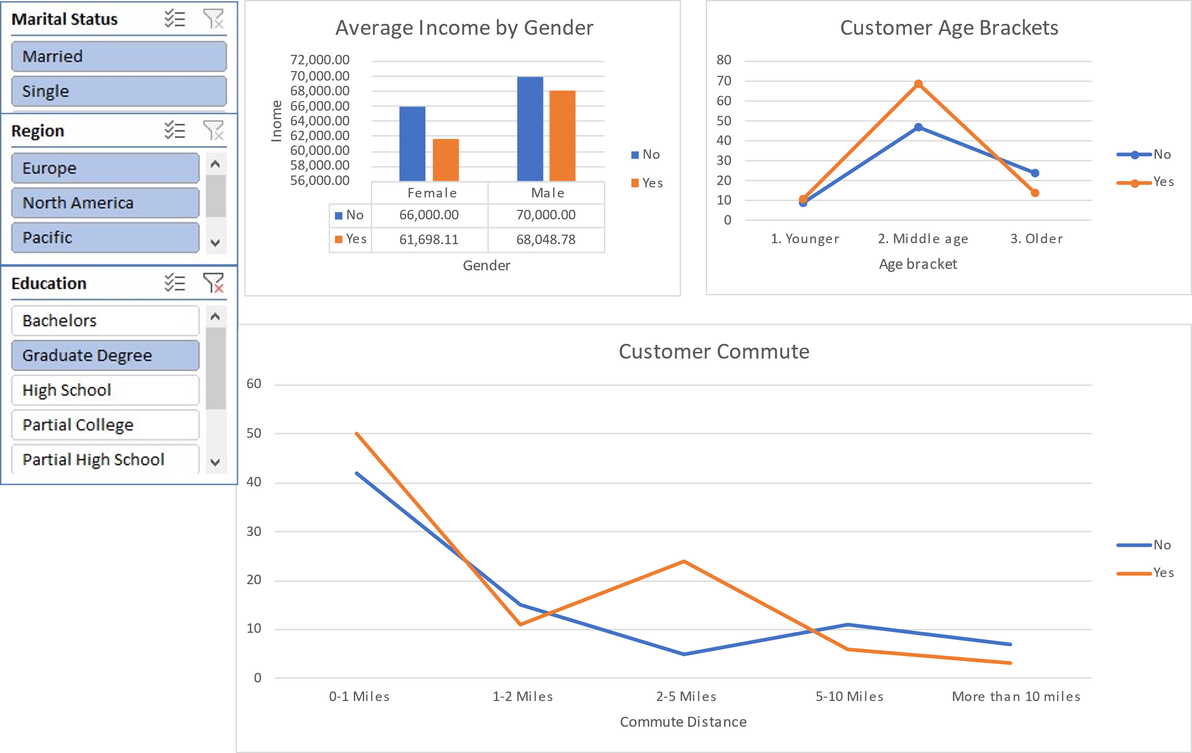
The dashboard

Slide 7
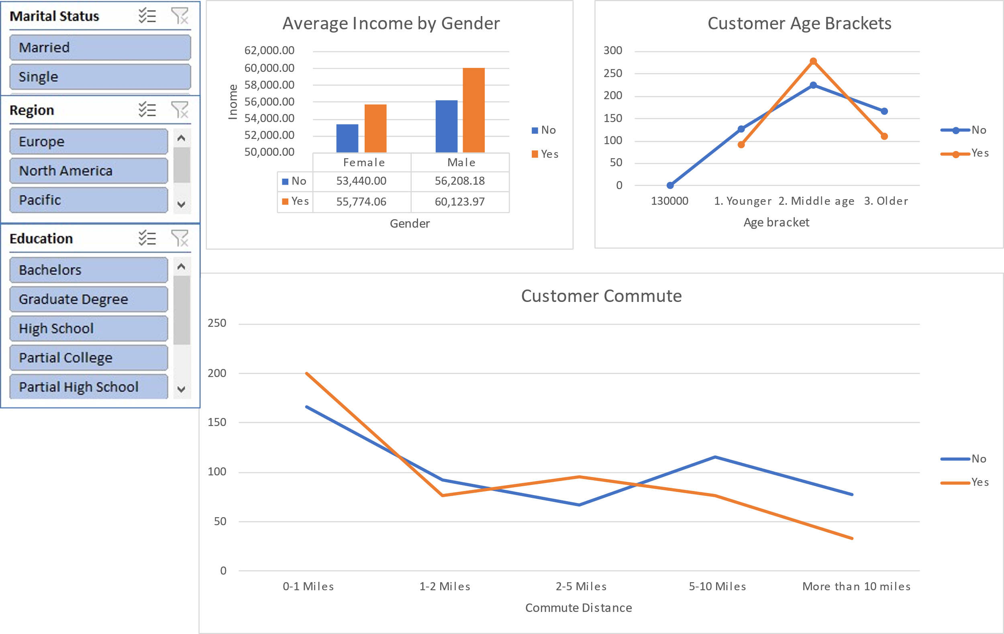
What we can learn: Gender
Men are more likely to make purchases, particularly if they are a higher earner and single. This imbalance levels out in Europe.
However, this trend reverses if they have a degree.

Slide 8
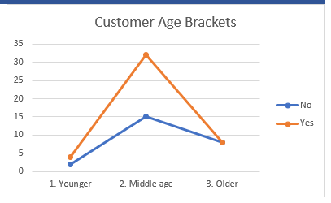
What we can learn: Age
Age boundaries: Young is under 35, Older is over 50.
The Largest difference between customers making a purchase is in single, middle-aged people.

Slide 9
What we can learn: Commute
Europe (and to a lesser extent, the Pacific) are more focused on shorter commutes.

Slide 10

The average customer
Gender: Men are more likely to make purchases, particularly if they are a higher earner and single. This imbalance levels out in Europe.
Age: The average customer is middle aged.
Commute: If they live in Europe or the Pacific, they will have a shorter commute. This may be due to living in an urban setting.

Slide 11
Limitations
Differences between regions may be due to location or cultural factors. Further data would be needed to better understand this.
The data only measures if a customer made a purchase, not how much they spent.
This data is based on questionnaire respondents. There is no data to say whether they are indicative of the local populations or our bike store customers.

Slide 12
Thank you
Michael Collins
m.collins.data@gmail.com

